Slide 1
Dismantling Colonialism
-- African Independence
Until lions tell their tale, the story of the hunt will always glorify the hunter
-African proverb

Slide 2
African Response
Despite the unpopularity of colonial rule, many Africans had to initially accept the authority of the colonial state
some collaborated for special privileges, and/or having access to medical help, and educational and or business opportunities.
some African people even saw colonization as progressive and civilizing.
But for many African leaders, elders and families the feelings of discontent with colonial oppression did arise …

Slide 3
During colonial rule
Africans expressed many forms of resistance to European rule
The two most common responses to colonialism were to …
actively fight back either through a forming a movement of resistance that might have culminated in organized rebellions
Or
They strove to form political organizations with the hopes to join legislative bodies and create laws for improved human rights and eventual freedom and independence for native Africans.
Many Organizations were formed to protest various elements of colonial rule

Slide 4
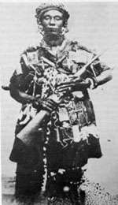
“I shall call upon you my fellow women. We will fight the white men. We will fight until the last of us falls in the battlefield."
Often women led efforts of resistance
Yaa Asantewaa
Yaa Asantewaa was an Ashanti queen who led an armed resistance to the colonization of Ghana by the British. She succeeded in the short run, but the Ashanti were heavily outgunned.
Notes:
Photos: Ashante Queen and Nigerian women
“African Women of Revolution” from Tribal Immunity: for Africans at home and abroad
http://www.google.com/imgres?imgurl=http://2.bp.blogspot.com/_fLH5BoGNg7w/SW3aTn

Slide 5
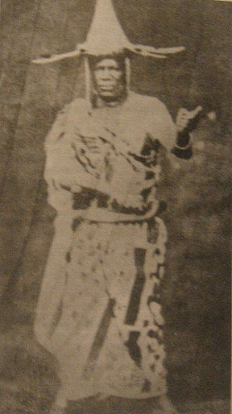
Colonial masters took control and stole natural resources for economic gain
Many Africans caught on to the exploitation
Chief Jaja (Nigeria)
Jaja was a chieftain at the time Nigeria was colonized
he fought against the British because of what he considered the many injustices that occurred in his dominion.
The colonial master's robbed farmers and stole the resources of the land and he, as chief was openly against this.
In the end, he was caught by colonial officers and exiled from the region he once served.
Notes:
(Photo British in Nigeria)
See full size image
838 × 640 - 291k - jpg - www.webafriqa.net/.../ pictures-Images/4.jpg
Image may be subject to copyright.
Below is the image at: www.webafriqa.net/.../ pictures-Pages/Image4.htm

Slide 6
Key forces that led to African Nationalism
Missionary education created leaders through education, and provided a moral process of thinking that led to further questioning of African’s basic human rights
World Wars I and II weakened Europe, and thus their hold on Africa.
The ideology of Pan-Africanism from black leaders in the U.S. and the Caribbean provided global networks of support
The League of Nations/The United Nations challenged the practice of colonization, AND suggested it was better to support regions to eventually rule themselves.

Slide 7
Missionary schools -education
Fostering intellectual development which then was used to fight for freedom
Missionaries unfortunately displayed the disparities and contradictions
Taught a Christian doctrine that taught Africans to “expect equal and fair treatment”
But often fell short of delivering…by failing to challenge or by promoting the colonial officers’ agenda.

Slide 8
WWI and WWII
Africans were drafted to serve in both wars
The British enlisted more than 700,000 Africans to fight in their armies.
Irony: using “unfree” Africans to fight for freedom against German imperialism
Africans learned modern military skills, leadership, and what it meant to fight for freedom. Also, saw how limited the Europeans were with their power.

Slide 9
Aftermath of WWII
Economic conditions for Europe deteriorated
Became to expensive to maintain off shore colonies
And had a more difficult time upholding a resistance to suppress the nationalists movements
France and Britain looked for ways for a “honorable exit” from Africa.

Slide 10
A small group of educated Africans concerned with…
gaining full rights, mostly for educated Africans
More power in representative political bodies
Widen the scope of Africans in the political process

Slide 11
Following the conclusion of the Second World War (WWII)
Nationalist and Independence Movements in Africa increased
the departure of colonial governments from Africa occurred during the 20th century (1900s).
most of them occurring in the 1960s but continuing into the 1970s all the way up to South Africa’s liberation from white minority rule in 1994.
Notes:
Following the conclusion of the Second World War. (WWII)
Nationalist and Independence Movements in Africa increased and the departure of colonial governments came in bursts during the 20th century, most of them occurring in the 1960s but continuing into the 1970s all the way up to South Africa’s liberation from white minority rule in 1994.

Slide 12
The Journey to Independence
Various regions in Africa gained Independence over time, with the largest emergence of independent efforts occurring in the 1960s.
Some gained independence via social movements, leading to orderly transitions away from European rule.
But many leaders had to demand independence; they had to “agitate” for it.
some independence movements were more prolonged and violent
i.e., guerilla warfare, and decades of armed struggle

Slide 13
In British West Africa
(Ghana and Nigeria)
African leaders sought to improve their position through constitutional means
Petition for more representation on legislative councils
Tried to reduce the presence of “Indirect Rule” via chiefs appointed by colonial administrative officials.
Educated elites and chiefs were not always in conflict, because of kinship ties and some chiefs were also highly educated.

Slide 14
Other efforts working toward freedom
Railway workers organized trade unions, cocoa farmer and other actions to protest low prices for crops.
Market women in Nigeria, rioted to protest high taxes and harassment of colonial administrators
In rural areas, tax evasion was widespread
Other resisted voting by moving to live in other colonial states

Slide 15

Key events leading up to independence in Ghana
Chiefs and village people often tried to resist the policies of British rule
There were multiple wars between the colonial powers and ethnic groups – that occurred during colonization period
Processes of Decolonization intensified after WWII

Slide 16
Key events towards Independence
United Gold Coast Convention (UGCC)-called for self-governance
1948 rioting increased –
members of UGCC were arrested including, an important leader, Kwame Nkrumah
Later, by 1949 Kwame Nkrumah formed his own party
The Convention People’s Party (CPP)

Slide 17
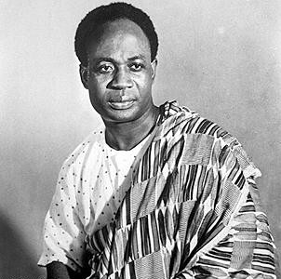
Nkrumah Promoted a Positive Action Campaign
Because of his leadership and a series of boycotts, strikes and civil disobedience
Nkrumah was imprisoned
After his CPP party gained majority seats in the legislative assembly
Nkrumah was released and appointed leader of government business
Notes:
Organized the “Positive Action” campaign 1950 civil disobedience, boycotts, strikes, non-cooperation. Nkrumah and CCP members were arrested by colonial authorities (3 years). Protests and resistance continued / the British decided to leave
Set up governance, created a new election. Nkrumah and his party dominated the legislative assembly. Released from Prison asked to form a government
Proposed his “Motion of Destiny” to the Assembly requesting independence within the British Common Wealth, and the Assembly approved it.

Slide 18
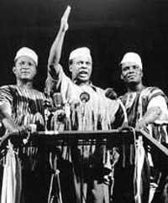
Ghana obtained independence in 1957/58
Through further negotiations with Britain
Became the Republic of Ghana (named after an ancient Islamic empire in the southwest Sahel region)
First president: Kwame Nkrumah; Founding member of the Organization of African Unity (OAU)
Notes:
Influenced by Marcus Garvey and C.L.R. James, as well as others from the Trotskyist Intellectual group. Met George Padmore in London helped to organize the 5th Congress on Pan-Africanism. Later Founded the West African National Secretariat to work on the decolonization of Africa. Founding member of the Organization of African Unity (OAU)

Slide 19
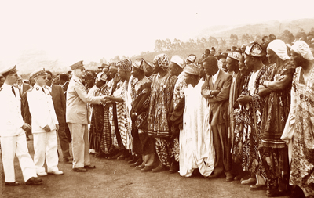
Key events leading up to
Nigeria’s independence
Following WWI demands for independence and Nigerian nationalism grew
Successive constitutions were legislated
by the British Government leading to a loose federation of self-governing states
1954 a federal system of government was created
Notes:
Emmanuel Konde The European colonizer never danced with the colonized African throughout the colonial period until the eve of independence.
http://www.postnewsline.com/2009/10/discourse-on-the-source-of-corruption-the-harvest-of-decolonization-in-postcolonial-africa.html

Slide 20
Nigeria was granted full independence in October 1960
a federation of three regions – Northern, Western, and Eastern
Prime minister Sir Abubakar Tafawa Balewa
leading a coalition government of conservative parties
Cultural and political differences amidst the groups created sharp tensions
Nigerian Peoples Congress (NPC)-(Northerners and Islamic Faith)
National Council of Nigeria and the Cameroons (NCNC)-Igbo (Easterners and Christian dominated)
Led by the Governor General: Nnamdi Azikiwe
Opposition held by liberal section,
Action Group (AG) (Westerners and Yoruba ethnic group)

Slide 21
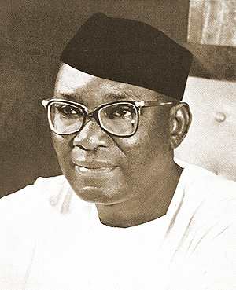
1963 The Federal Republic of Nigeria
Nnamdi Azikiwe governor general 1960
Nnamdi Azikiwe 1st president
Southern Cameroon opted to join the Republic of Cameroon
Northern Cameroon chose to stay with Nigeria
Nation parted with Britain’s influence completely in 1963
Held elections
In October 1963, Nigeria proclaimed itself a federal republic, Nnamdi Azikiwe
Notes:
A nationalist and supporter of African Unity. Espoused a philosophy of African Liberation-Zikism-spiritual balance, social regeneration, economic determination, mental emancipation and political resurgence.

Slide 22
watch
Africa: States of Independence – the Scramble for Africa
http://www.youtube.com/watch?v=LbT44HwzNrI
44:54 min. (advance to 23.36 min. African nationalism & Independence), (go to 33.38 min. for conditions of post-independence
See the video African students from ISU comment on the economy in their countries.12:57 mins
https://www.youtube.com/watch?v=GE-B-Tiyd6s

Slide 23
AFRICA A Voyage of Discovery in HD:
The Rise of African nationalism
https://www.youtube.com/watch?v=EUsgu32zuZ0

